Slide 1
Web Applications with React
HackED 2022 | Intuit | Daniel Zhou

Slide 2

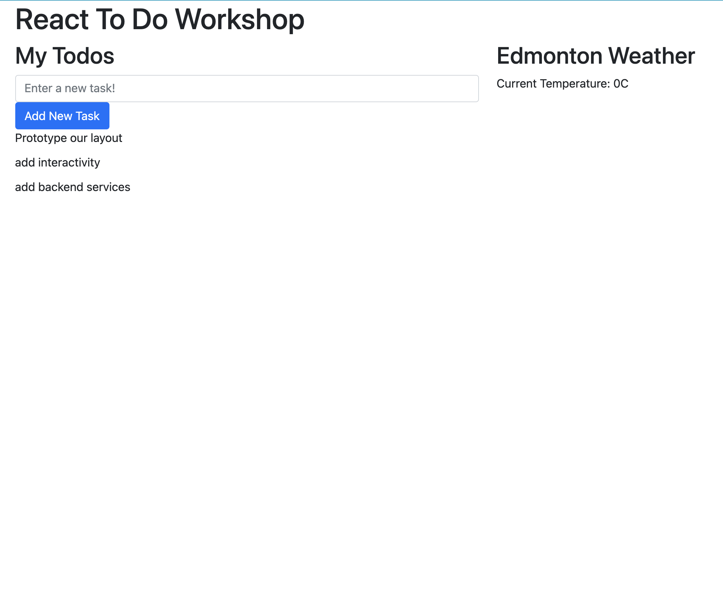
Takeaways
React?
What is it
Why should I use it?
Setting Up A Web Dev Environment
A To-Do App w/ Modern React Programming
Functional React Components
State Management via React Hooks
Backend Integration via React Hooks
Functional Programming

Slide 3


Overview / About Me
UAlberta Alumni 2017 & 2021
Work @ Intuit
QuickBooks Canada (Full Stack Dev.)
Intuit Globalization Platform (Backend Dev.)
Javascript, Java, Python, React, GraphQL, MongoDB, SQL, AWS, Splunk
Tech. Interests
Information Systems, Data Analytics, Data Visualization, Static Analysis Tooling

Slide 4
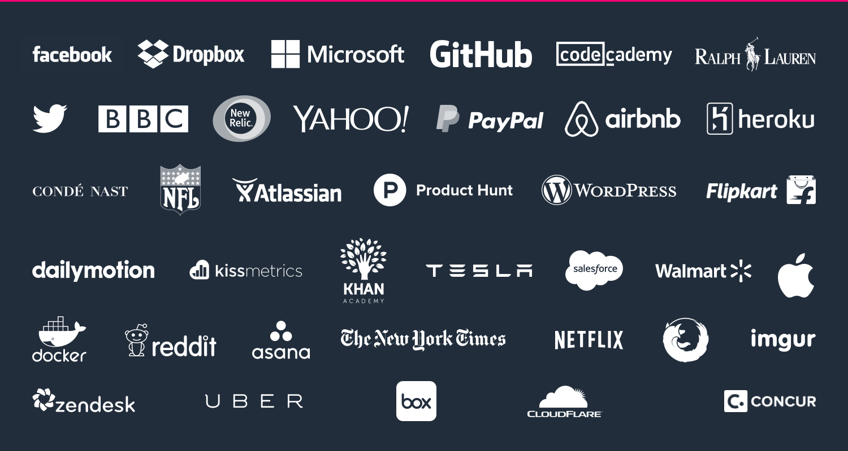
Overview / React Companies

Slide 5
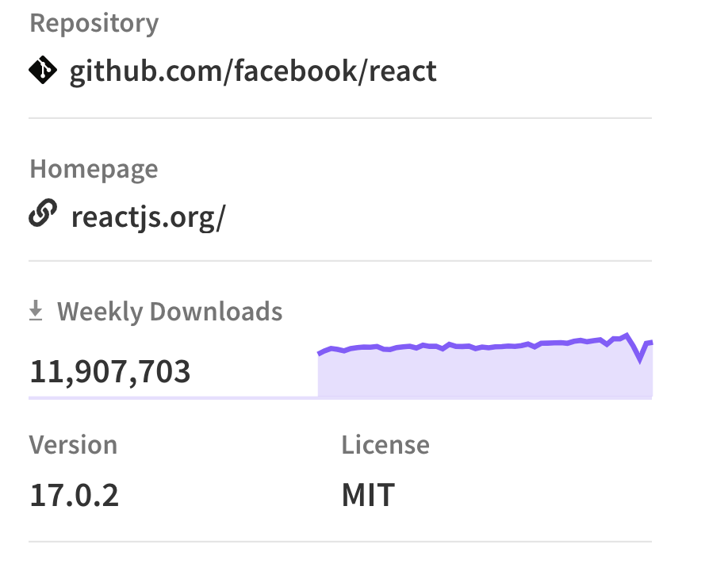
Overview / About React
What Is React
Front End Web App
Declarative
Component Based
FOSS
Why React? [1]
Most popular frontend web library – for good reasons.
Many Employers Use It

Slide 6
Setup
Install the development environment and the git repo.

Slide 7

Setup / The React Environment
Web Browsers
Downloads JavaScript, HTML, CSS and renders interactive pages.
React Is Just A Big JavaScript File
Your web app. is a bundle of the three.
Building The Bundle
NodeJS – Running JavaScript outside the browser.
create-react-app – A quick start package for building your web. app bundle.
Detail: Node & create-react-app handle a lot of configurations and development management for us. This’ll generate a lot of helpful scripts and services that’ll let us host our web app locally for the time being.

Slide 8
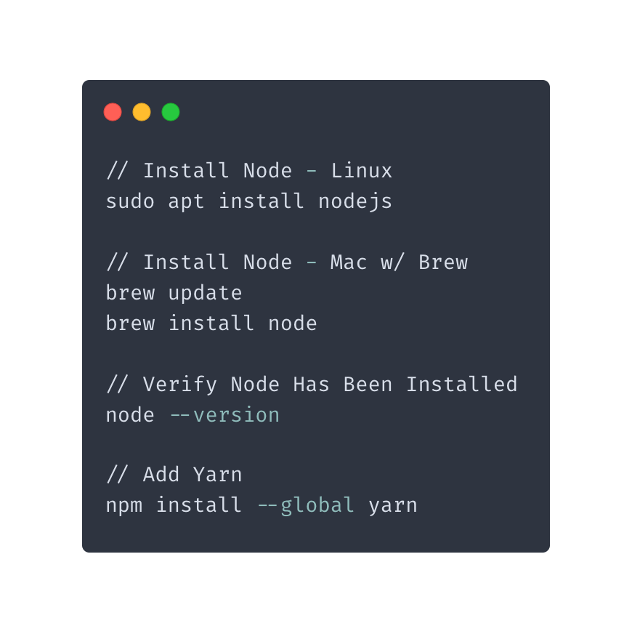

Setup / Install Node
Installers For Each OS: https://nodejs.org/en/
Commands we’ll use:
node – Like python or python3
yarn – A package manager like pip
Npm & yarn will help us install packages from the internet automatically. They do the same thing in slightly different ways. I prefer yarn so we’ll use one to install the other.

Slide 9
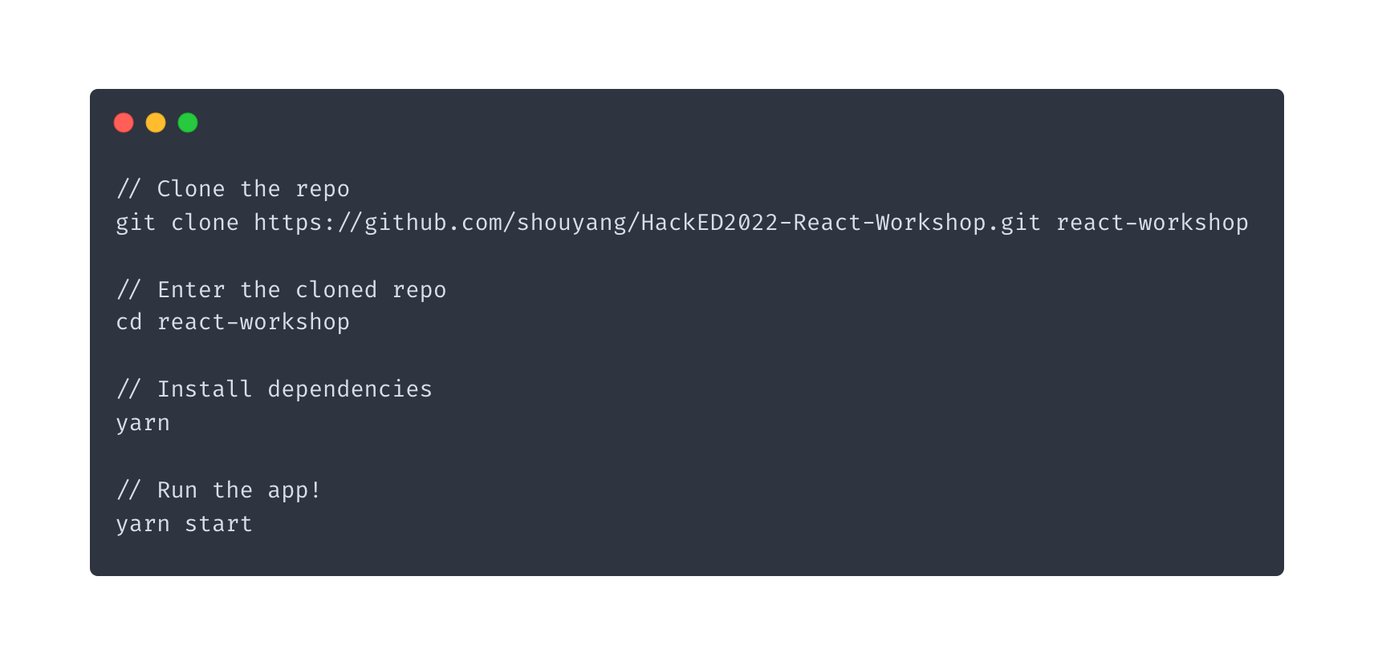
Setup / Clone The Repo
The repo was made via create-react-app.

Slide 10
Into To React!
Building a Single-Page Application With Functional Components

Slide 11
Project / Overview
The Project:
Build A React Component Based Single Page App
Track A List Of To-do Tasks
View Existing Tasks
Add / Delete Tasks
Fetch The Weather, And Display It ~ If we have time ~

Slide 12
Project / The Plan
Prototype your App Out.
Iteration 1 - Make placeholder components to layout the UI.
Iteration 2 – Makeover: style with Bootstrap-React components.
Introduce Interactivity
Iteration 1 - Add business logic for event handling with hooks.
Iteration 2 - Integrate with backend RESTFUL API to fetch the weather. (If there’s time)

Slide 13
React / Components
Functional components are just functions that follow a convention….
They take a props parameter following a convention:
props.* - Any parameters passed into the component.
props.children – A specific parameter denoting nested components.
And they return JSX (HTML + React Components)
Basically, they return recursively templated HTML.

Slide 14
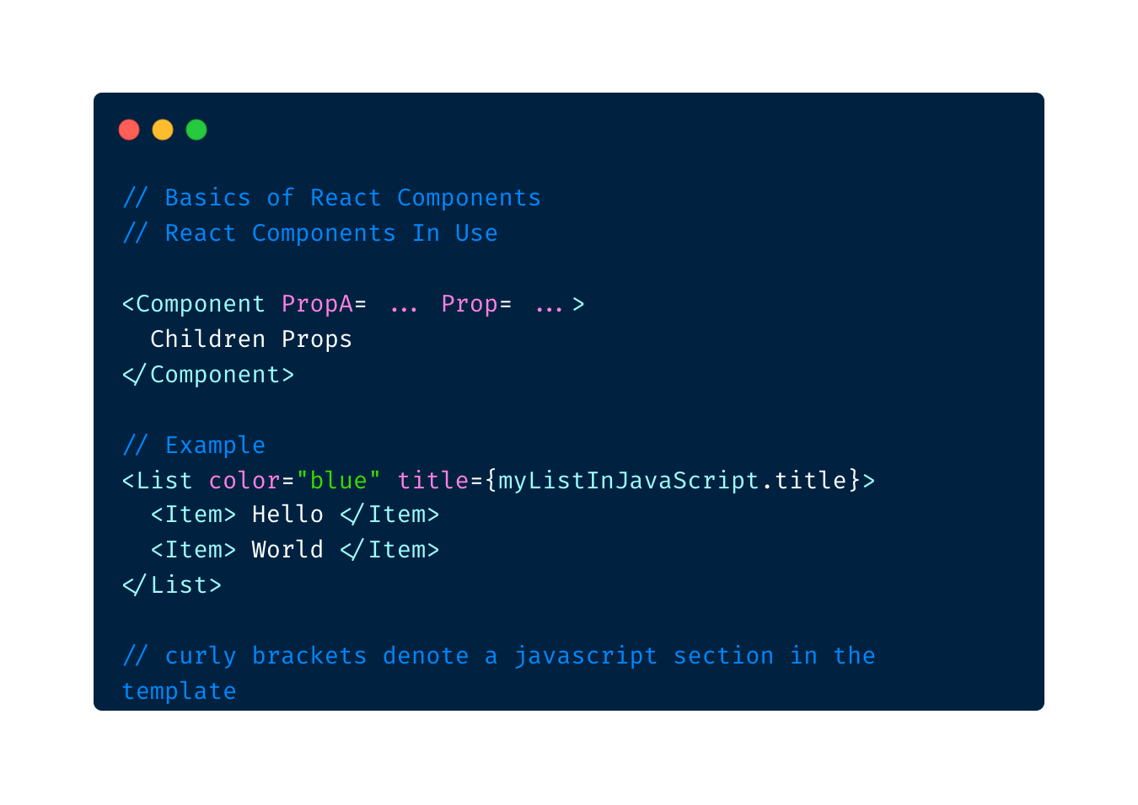
React / Components – The User View

Slide 15
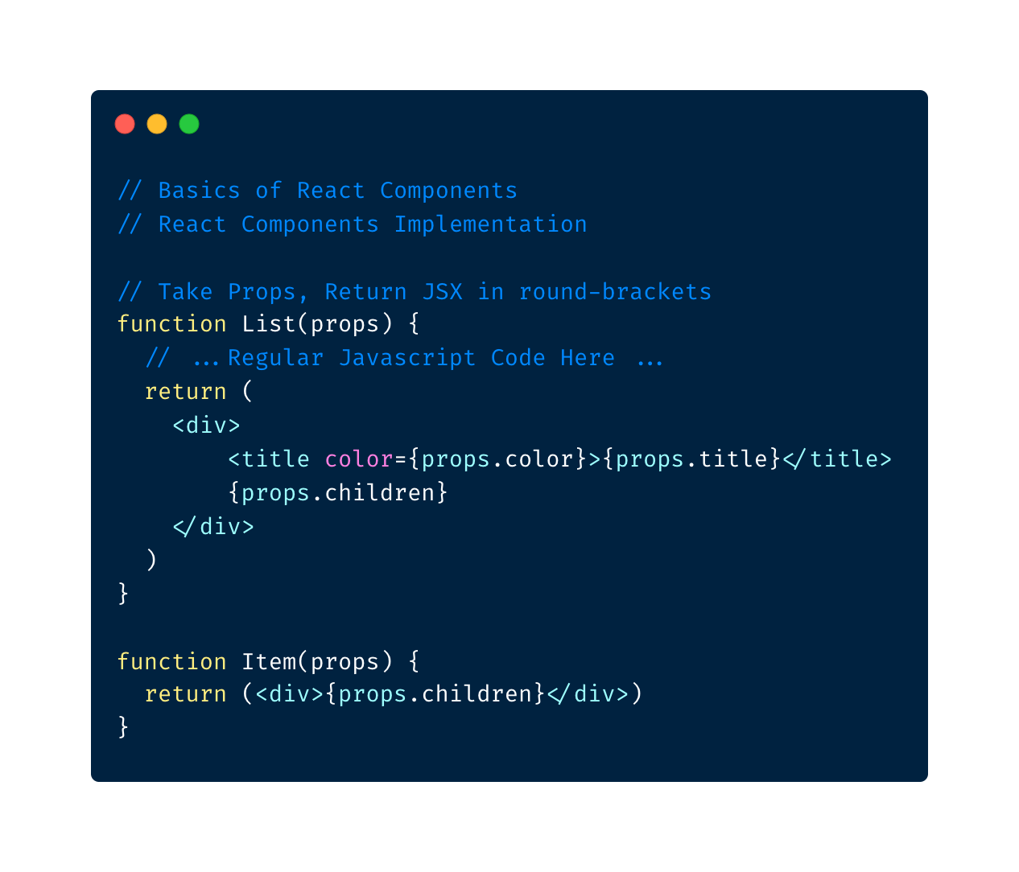
React / Components – The Implementation

Slide 16
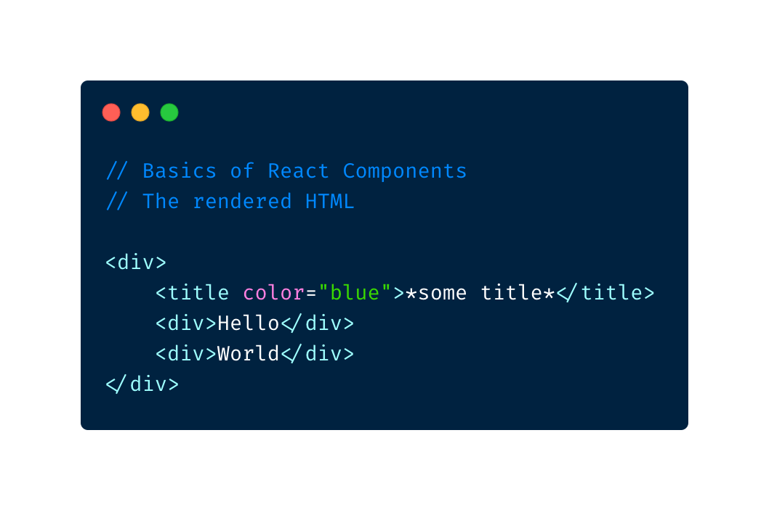
React / Components – The Rendered View

Slide 17
Live / Prototype Our App Layout

Slide 18
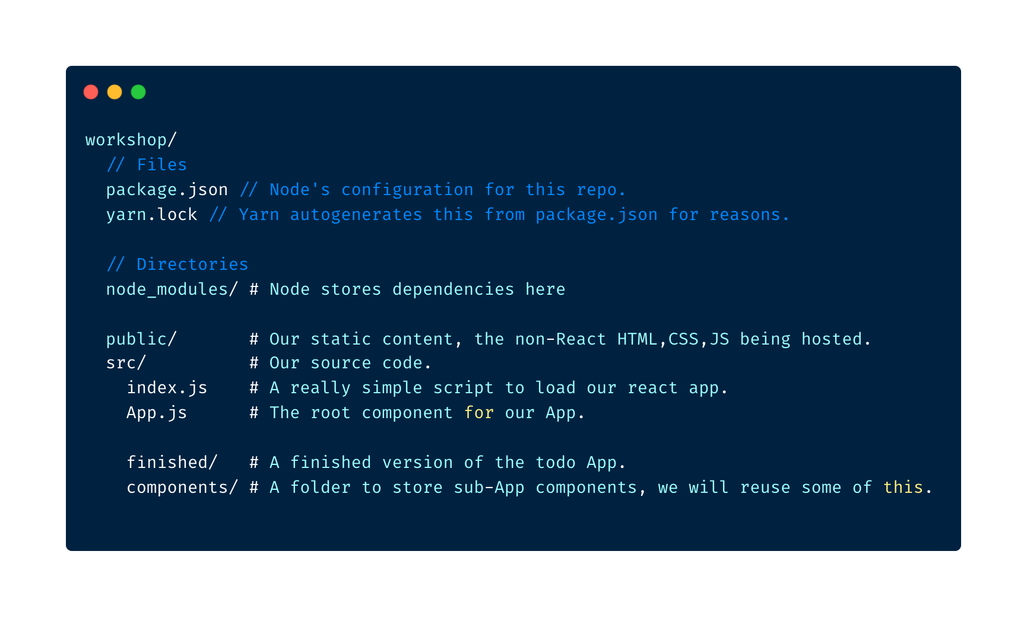
The Folder Structure

Slide 19
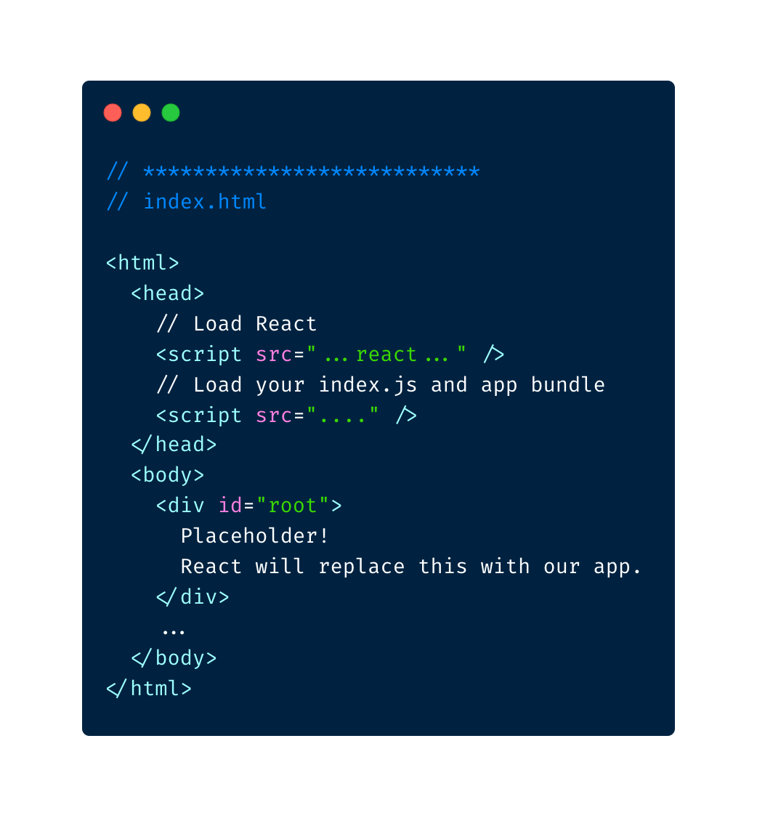
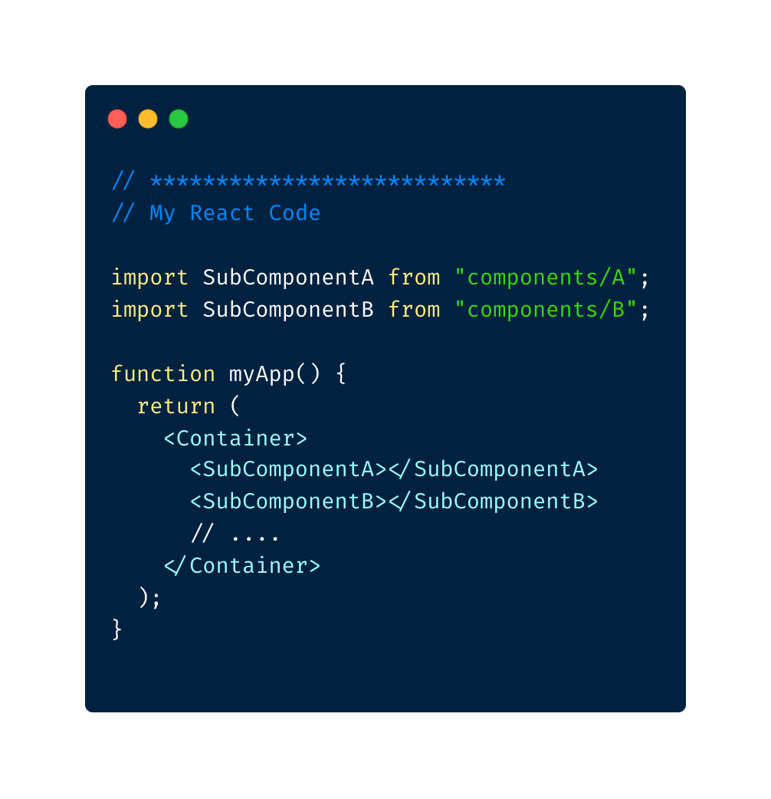
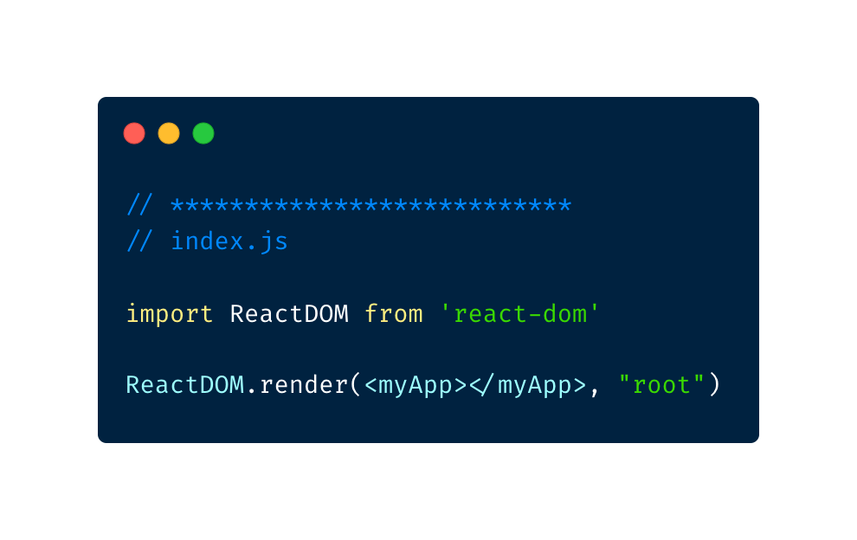
React / The Entire process

Slide 20
Library / Component Libraries
React has many popular UI Component libraries!
These’ll provide us high quality UI elements like Buttons, Forms, Modals, etc …
And lets us focus on building the App logic components.
The Bootstrap UI Framework
A Popular HTML, CSS, JS Framework …
… React-Bootstrap – Someone made Bootstrap into React Components.

Slide 21
Live / Refine Our App Layout

Slide 22
React / Hooks
React Hooks provide stateful behaviors to functions.
They use a lot of functional programming concepts under the hood.
We’re going to touch on two!
useState
Let’s us use a stateful variable inside our functional component.
useEffect
Let’s us call functions that’ll update this component and re-render it.
… where and when to fetch data and to avoid recursively rendering updates.
React also has class-based components but functional ones are the modern style. Functional components are simpler to write and test .

Slide 23
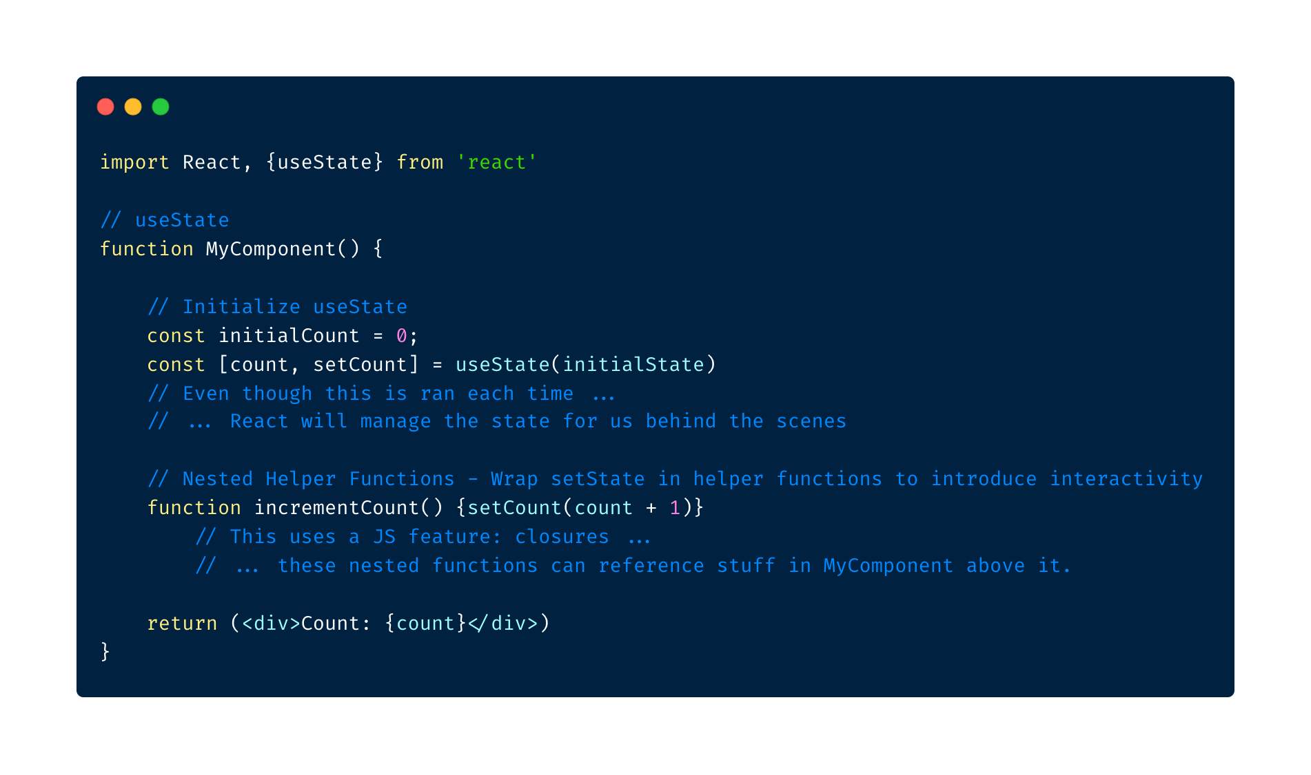
React / Hooks - Code

Slide 24
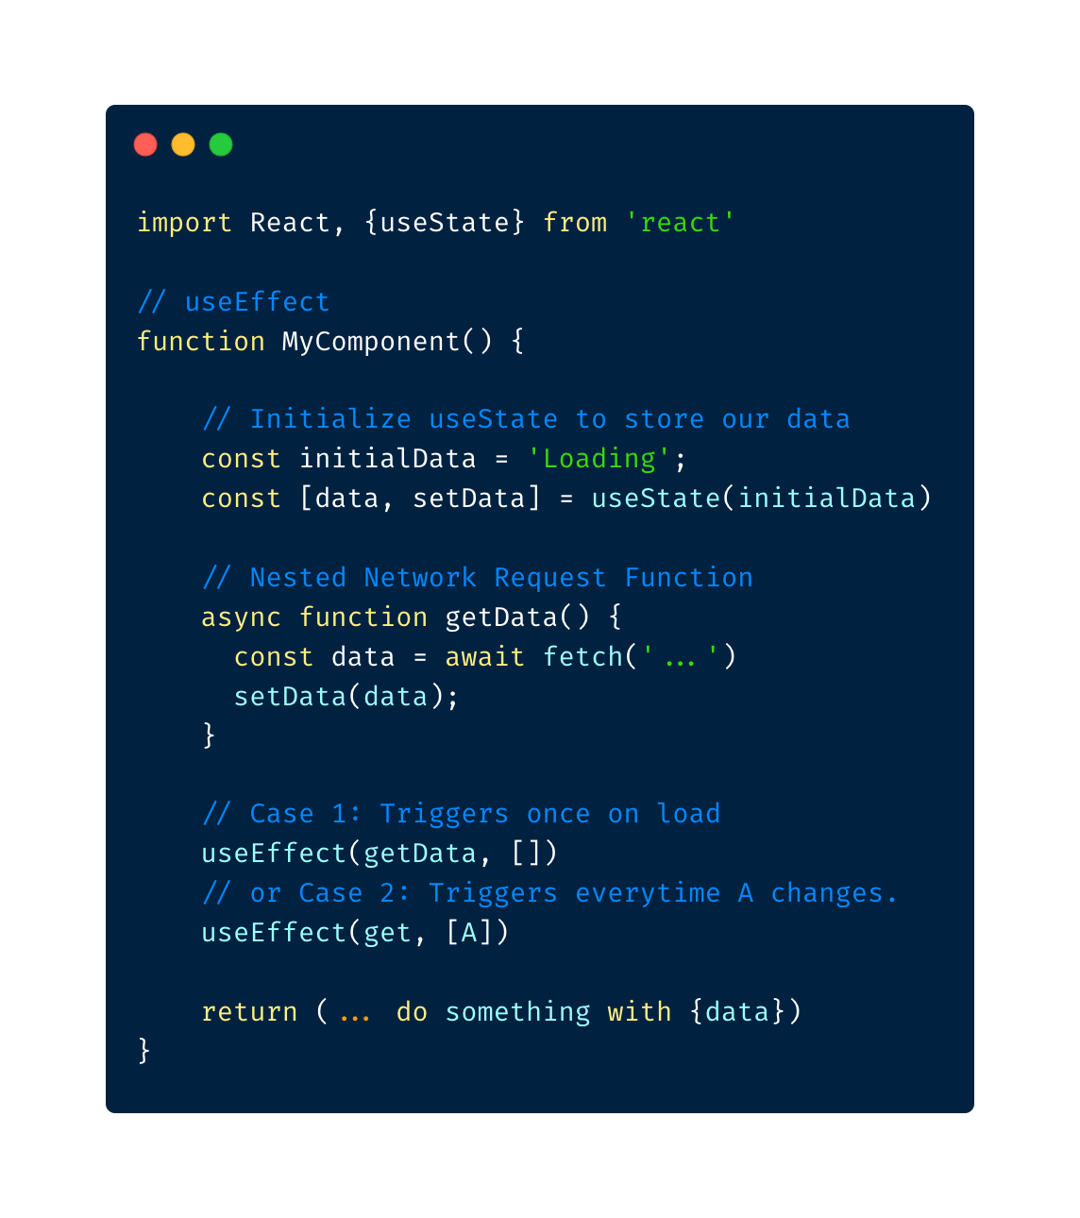
React / Hooks - Code

Slide 25
Live / Add Interactions & Integrations

Slide 26
Resources
Learning React
React Office Tutorial
W3 Schools
JavaScript
HTML
CSS
46b6ed9e2209248c56327b99510e53c9

